Slide 1
LEARNING FROM DISASTER
BY
P.VIKAS(19311A19G6)
B.SAITEJA GOUD(19311A19D9)
B.RISHI IVATSAVA(19311A19D8)

Slide 2
CONTENTS
INTRODUCTION
LITERATURE SURVEY
EXISTING SYSTEM
PROPOSED SYSTEM
DATA SET TAKEN
ATTRIBUTES
SYSTEM REQUIREMENTS
CONCLUSION AND FUTURE SCOPE

Slide 3
INTRODUCTION
In this project we try to find, the correlation between the survival and the demise rate of the passengers travelling in the ‘rms titanic’ when the massive ship sunk in the ‘North Atlantic’ ocean due to an accidental ‘ship-wreck’.
The idea is to apply different machine learning algorithms and compare the results to the optimal values mentioned in the datasets provided by ‘kaggle’ website and achieve the optimal result. The attributes that could determine the correlation between survival and the demise of passengers such as the age, gender, passenger-class, passenger-id, and some other essential attributes are considered.

Slide 4
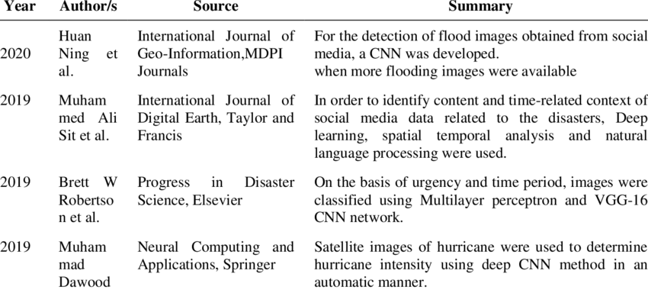
LITERATURE SURVEY

Slide 5
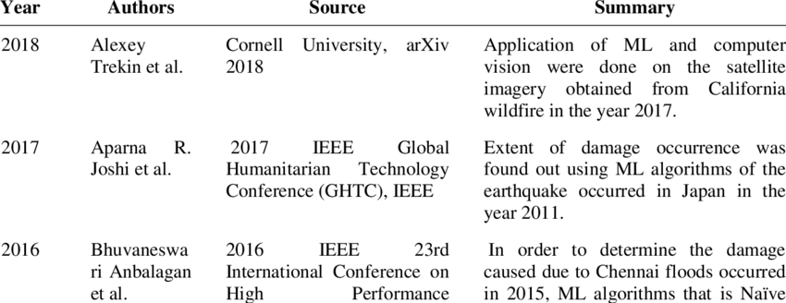

Slide 6
EXISTING SYSTEM
Many researchers have worked on the Titanic problem in order to compare various different machine learning techniques in terms of efficiency of algorithm to predict the survival of passengers.
Studies have tried to trade-off between different features of available data set to provide the best prediction results.
The titanic is used in problem to compare and contrast between algorithms: NAVE BAYES, DESCION TREE analysis.

Slide 7
ALGORITHMS USED
XG-BOOST: Extreme Gradient Boosting, also known as XGBoost, is a machine learning algorithm renowned for its remarkable performance and adaptability in addressing a variety of predictive modelling issues. It is a member of the family of gradient boosting algorithms, which combine several decision trees or other weak predictive models to produce a single strong predictive model.
Gradient Boosting Algorithm: A well-liked machine learning approach called gradient boosting is utilised for both classification and regression problems. It is a member of the ensemble technique family, which combines several weak learners typically decision trees to produce a powerful prediction model.

Slide 8
3. KNN:A straightforward and understandable machine learning technique called K-Nearest Neighbours (KNN) is employed for both classification and regression applications. It operates under the premise that labels or values for related data points have a tendency to be similar.
4. Support Vector Classifier: SVC stands for Support Vector Classifier in the algorithm. Given that it is a machine learning technique used for classification tasks, it aids in determining which category or class a new data point belongs to.

Slide 9
DECISION TREE ALGORITHM
Decision tree is a supervised learning algorithm. This is generally used in problems based on classification.
It is suitable for both categorical and continuous input and output variables.
Each root node represents a single input variable (x) and a split point on that variable. The dependent variable (y) is present at leaf nodes.
For example: Suppose there are two independent variables, i.e. input variables (x) which are height in centimeter and weight in kilograms and the task to find gender of person based on the given data. (Hypothetical example, for demonstration purpose only).

Slide 10
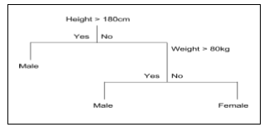
DECISION TREE EXAMPLE

Slide 11
PROPOSED SYSTEM
In this work the goal is to analyze the disaster datasets probably, in this work titanic dataset was used and make a comparative analysis of the supervised machine learning methods like decision trees, random forest, KNN,XG-boost, Gradient boosting algorithms.
The generated or constructed models are used to evaluate by using the test data set and their respected results were used to make a comparative analysis of both methods.
This study shows the importance of choosing important features and obtaining good data.

Slide 12
LOGISTIC REGRESSION
Logistic regression is the technique which works best when dependent variable is dichotomous (binary or categorical).
The data description and explaining the relationship between one dependent binary variable and one or more nominal, ordinal, interval or ratio-level independent variables is done with the help of logistic regression.
It is used to solve binary classification problem, some of the real life examples are spam detection- predicting if an email is spam or not, health-Predicting

Slide 13
RANDOM FOREST
Random forest algorithm is supervised classification algorithm. The algorithm basically makes forest with large number of trees.
The higher the number of trees in the forest gives the higher accuracy results. Random forest algorithm can be used for both classification and regression problems
For instance, it will take random samples of 100 observation and 5 randomly chosen initial variables to build a model.
The same process is repeated a number of times, then the final prediction is made according to the observations. Final prediction is a function (mean) of each prediction.

Slide 14
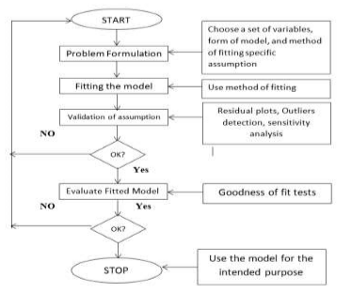
PROPOSED SYSTEM FLOW

Slide 15
DATA SETS TAKEN
The dataset used for the paper is provided by the Kaggle website. The data consists of 891 rows in the train set which is a passenger sample with their associated labels .
For each passenger, the name of the passenger, sex, age, his or her passenger class, number of siblings or spouse on board, number of parents or children aboard, cabin, ticket number, fare of the ticket and embarkation were provided.
The data is in the form of a CSV (Comma Separated Value) file. For the test data, the website provided a sample of 418 passengers in the same CSV format.

Slide 16


Slide 17
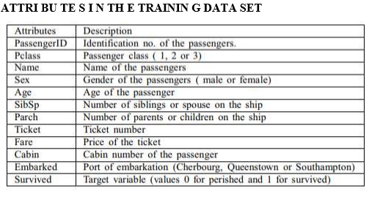
ATTRIBUTES

Slide 18
SYSTEM REQUIREMENTS:
HARDWARE REQUIREMENTS
Windows 7/8/10
RAM 4GB
Hard disk 160 GB
SOFTWARE REQUIREMENTS
Python (3.6.2/5/6/7/8)
TOOLS USED
Weka, Python, R, Java etc.

Slide 19
LIBRARIES USED
Numpy
Pandas
Matplotlib
Seaborn
Sklearn

Slide 20
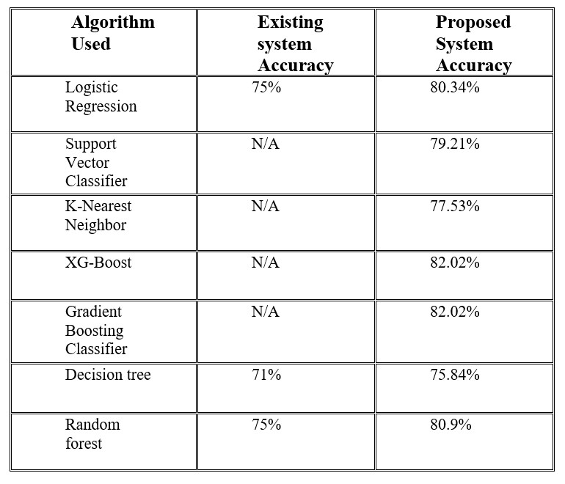
Results

Slide 21
CONCLUSION AND FUTURE SCOPE
Gives the survival rate from the disaster and helps to make pre-cautionary measures in future.
It would be interesting to continue this analysis with other possible features like identifying the patterns in titles of passenger names and also with other supervised machine earning algorithms

Slide 22
REFERENCES
P. K. Chahal, S. Pandey, and S. Goel, ‘‘A survey on brain tumor detection techniques for MRimages,’’ Multimedia Tools Appl., vol. 79, nos. 29–30, pp. 21771– 21814, May 2020.
[2] K. Muhammad, S. Khan, J. D. Ser, and V. H. C. D. Albuquerque, ‘‘Deep learning for multigrade brain tumor classification in smart healthcare systems: A prospective survey,’’ IEEE Trans. Neural Netw. Learn. Syst., vol. 32, no. 2, pp. 507–522, Feb. 2021.
[3] E. S. A. El-Dahshan, T. Hosny, and A. B. M. Salem, ‘‘Hybrid intelligent techniques for MRI brain images classification,’’ Digit. Signal Process., vol. 20, pp. 433–441, Mar. 2010.
[4] Z. Dong, G. Ji, J. Yang, Y. Zhang, and S. Wang, ‘‘Preclinical diagnosis of magnetic resonance(MR) brain images via discrete wavelet packet transform with Tsallis entropy and generalized eigenvalue proximalsupport vector machine (GEPSVM),’’Entropy, vol. 17, no. 4, pp. 1795–1813,Mar. 2015.
[5] A. Sawant, M. Bhandari, R. Yadav, R. Yele, and M. S. Bendale, ‘‘Brain cancer detection fromMRI: A machine learning approach (tensor flow),’’ Int. Res. J. Eng. Technol., vol. 5, no. 4, pp. 2089–2094, Apr. 2018

Slide 23
THANK YOU!!!!

